Slide 1
Basic Calculator
Adhiyamaan college of engineering
DHANU SHRI .J

Slide 2
Problem statement
Description:
In this assignment, you will create a basic calculator using HTML, CSS, and JavaScript. The goal of this project is to develop a functional calculator that can perform arithmetic operations, such as addition, subtraction, multiplication, and division. This project will help you practice your front-end development skills and enhance your understanding of web technologies

Slide 3
introduction
This project involves the creation of a simple calculator using HTML and CSS. The calculator will perform basic arithmetic operations such as addition, subtraction, multiplication, and division. This report covers the design, implementation, and functionality of the calculator.

Slide 4
objectives
To create a functional calculator interface using HTML.
To style the calculator using CSS to make it visually appealing.
To ensure the calculator performs basic arithmetic operations correctly.
Technologies Used :
HTML: For structuring the content of the calculator.
CSS: For styling the calculator to improve its visual appearance.

Slide 5
Functionality
The calculator performs the following functions:
Display: Shows the current number or result of the calculation.
Buttons: Includes buttons for digits (0-9), operations (+, -, *, /), clear (C), and equals (=).
Operations: Performs basic arithmetic operations.

Slide 6
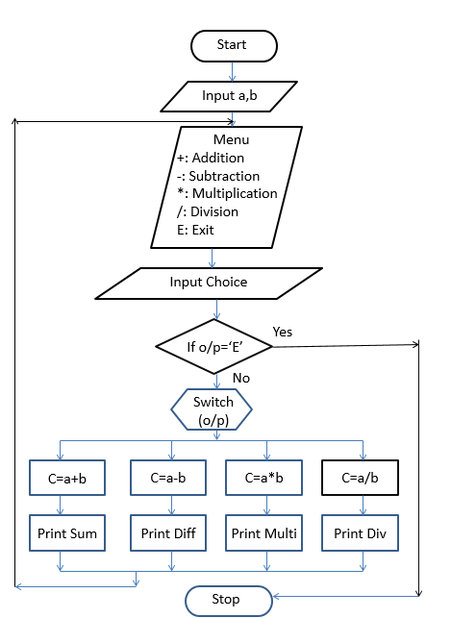
Flow diagram
The calculator should be able to perform the following operations:
Addition
Subtraction
Multiplication
Division
The calculator should display the result of each operation on the display screen.

Slide 7
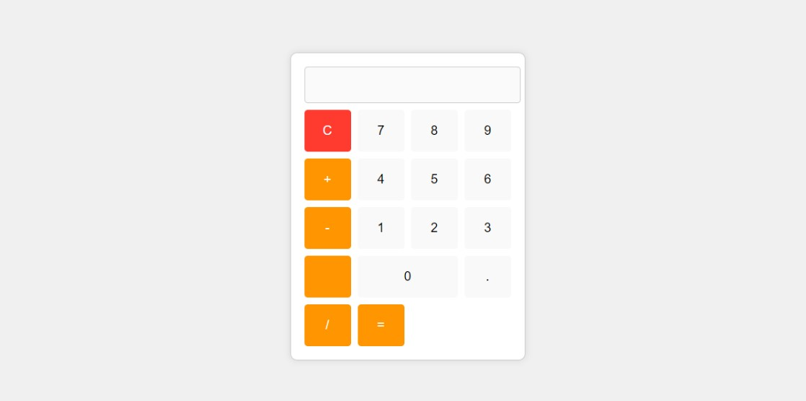
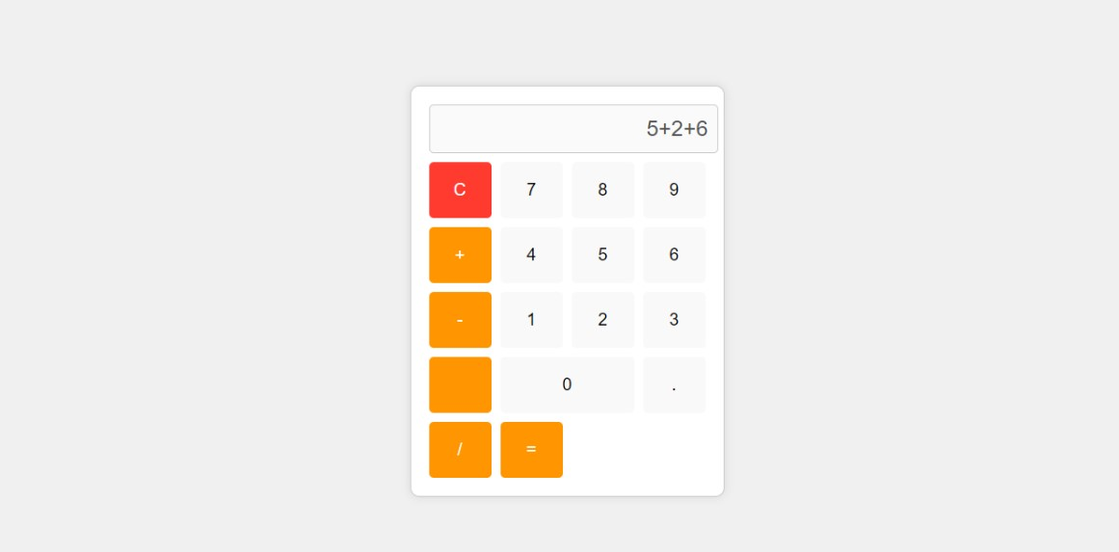
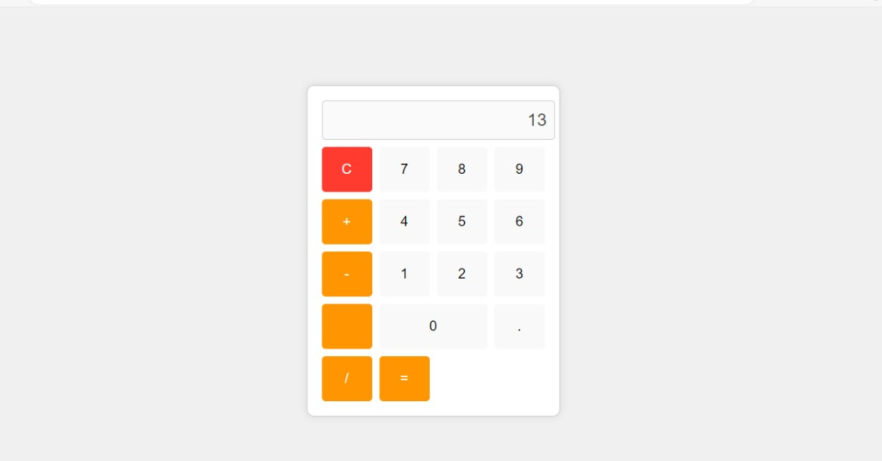
STEP BY STEP :

Slide 8
conclution
This project successfully created a simple calculator using HTML and CSS. The calculator performs basic arithmetic operations and has a user-friendly interface. This project demonstrates fundamental web development skills, including structuring HTML content and applying CSS styles.

